Slide 1
The automatic identification of public interest in the fields of audit, assurance, and ethical standards
Kevin Moffitt, Ph.D.
WCARS 48 -- September 24, 2020

Slide 2
Preview of Results
Audit Quality | IOSCO 2018 – “this may provide an effective safeguard that a decision is not unduly influenced by a low audit fee in circumstances where audit quality may be compromised.”
Auditor Independence | IGCN – “so, as you can see, while things have changed since the passage of the sarbanes-oxley act, it appears that new threats to auditor independence have emerged, and that others have reappeared.”
Going Concern | ESMA 2019 – “accordingly, the fair value of the land should be determined based on the current use of the land in view of the going concern principle.”
Fraud | THEIA 2019 – “would it be possible to devise a 'reasonable person' test in assessing the auditors work in relation to fraud detection?”
Professional Skepticism | THEIA 2019 – “annually it should assert why it believes the auditor has been challenging and exercised professional skepticism.”

Slide 3
Overview – Public Interest Oversight Board
PIOB: Global independent oversight body that seeks to improve the quality and public interest focus of the international audit and assurance, and ethics standards formulated by the Standard Setting Boards supported by the International Federation of Accountants.
attitude towards auditing standards
PIOB
Oversight
IAASB
IESBA
Auditing Standards
Accounting Ethics Standards
Notes:
The Public Interest Oversight Board (PIOB) provides independent oversight of the activities of the International Audit and Assurance Standard Setting Board (IAASB) and International Ethics Standard Setting Board for Accountants (IESBA), supported by the International Federation of Accountants (IFAC) to ensure that they are responsive to the Public Interest. Thus, a critical task for PIOB is to obtain an accurate portrayal of the Public Interest. In this project, we propose methods for automatically detecting, collecting, and analyzing public interest data from digital resources available on the Internet. A successful project will allow PIOB to obtain a broader and deeper awareness of the public interest related to the international standards developed by the IAASB and IESBA. This will in turn assist PIOB in its chartered mission to oversee the responsiveness of IAASB and IESBA activities to the public interest.

Slide 4
Improving PIOB Oversight
Who uses International Auditing Standards?
Auditors
Regulators
Investors
Financial Institutions
Corporations
What do users think about these standards?
This constitutes public interest
Remember PIOB mission: [to] improve the quality and public interest focus of the international audit and assurance… standards formulated by [IAASB]
PIOB
Oversight
IAASB
Auditing Standards
Auditors
Regulators
Investors
Financial Institutions
Public Companies

Slide 5
Main Objective
Supply PIOB with information regarding the public interest in the field of audit and assurance.
Methodology
Identify topics of public concern related to auditing and assurance standards from resources available on the Internet

Slide 6
Internet Resources
PIOB and IFAC provided a list of relevant Internet resources
Investors and Users
https://www.theia.org/
https://www.icgn.org/
https://betterfinance.eu/
https://www.efama.org/
https://europeaninvestors.eu/
https://www.afme.eu/
https://www.sifma.org/
http://www.efr.be/
Regulators and Government
https://www.ifiar.org/
https://www.frc.org.uk/
https://pcaobus.org/
http://www.cpab-ccrc.ca/
http://www.h3c.org/accueil.htm
https://www.fsa.go.jp/en/index.html
https://www.irba.co.za/
https://asic.gov.au/
https://www.bis.org/bcbs/
https://ec.europa.eu/commission/index_en
http://www.fsb.org/
https://www.iaisweb.org/home
https://www.iosco.org/
http://www.ipiob.org/
http://www.worldbank.org/ https://www.esma.europa.eu/
Professional Accountancy Organizations
https://www.icaew.com/
https://www.globalaccountingalliance.com/about
https://www.accountancyeurope.eu/
https://www.accaglobal.com/gb/en.html
https://www.cimaglobal.com/
https://www.aicpa.org/
https://www.cpacanada.ca/
https://www.efaa.com/ https://www.cpaaustralia.com.au/ https://www.charteredaccountantsanz.com/

Slide 7
Initial Selection of Websites
Investors and Users
The Investment Association (www.theia.org)
International Corporate Governance Network (www.icgn.org)
SIFMA (www.sifma.org)
“voice of [America’s] securities industry”
Regulators and Government
International Organization of Securities Commissions (www.iosco.org)
European Securities and Markets Authority (www.esma.europa.eu)
Notes:
SIFMA is an American organization that advocates for

Slide 8
Methodology
Web Scraping
Write scripts for each individual website
Labor intensive
Convert to Plain Text
Convert PDF and HTML to text
Further clean the text
Develop Database
Load text into the database
Keep track of documents and features
Identify Topics
Classify Documents
Identify documents related to accounting and auditing
Extract the associated raw text for manual inspection
Find relevant topics within each document
Organizations discuss a wide variety of topics
Notes:
To gain access to the content of each website we will rely on web scraping. The content will be cleaned and then organized in a database or related technology in preparation for data processing. To process the data, we will begin by identifying text related to key words and concepts provided by the PIOB. The CARLAB team will work with PIOB and IFAC to create the initial list of words, phrases, and concepts. A preliminary list provided informally by PIOB and IFAC includes the following terms:

Slide 9
Web Scraping Documents
www.theia.org
Responses and Representations (207)
Press Releases (524)
www.icgn.org
Policy Letters (138)
Special Moments (22)
www.sifma.org
Comment Letters, White Papers, Amicus Briefs, etc…(965)
www.iosco.org
Public Reports (629)
Media Releases (534)
www.esma.europa.eu
Reports, Letters, Opinions, Speeches, Recommendations, etc… (4332)
Total = 7251 documents

Slide 10
Convert Documents to Plain Text
Used Python libraries to convert PDFs/HTML to plain text
Diverse document types and sources lead to non-standard formatting in text
headers
footers
tables
etc…
Standardize the text by converting each document to a list of sentences
Required a sentence parser

Slide 11
Filter Documents
To reduce false positives, eliminate documents with no discussion of accounting topics
Two-filter solution:
Filter 1: Select documents that have language like that found in an accounting and auditing glossary
Filter 2: Select documents that contain accounting or auditing related topics (LDA analysis)
661 relevant documents were identified using metrics based on these two filters

Slide 12
Identify Topics in Relevant Documents
Topics Selected by PIOB and IFAC
accountability | ethical requirement
accounting estimates | ethics
audit deficiencies | fee dependency
audit failures | fraud
audit business model | going concern
audit network | technology
audit quality | data analytics
audit scandals | non-assurance services
auditor independence | noncompliance regulations
auditors opinion of internal controls | noncompliance laws
audits of less complex entities | objectivity
business model | professional skepticism
conflict of interest | self review
credit loss estimates | sustainability
critical mindset | internal controls
emerging forms of external reporting | external reporting
 | ethical behavior

Slide 13
Most Mentioned Topics
TopicText | TopicDocumentCount | Topic Count
accounting estimates | 108 | 287
audit quality | 97 | 1641
accountability | 78 | 178
business model | 65 | 211
technology | 58 | 118
going concern | 55 | 222
auditor independence | 52 | 347
objectivity | 45 | 98
sustainability | 45 | 155
ethics | 44 | 205
external reporting | 44 | 58
internal controls | 42 | 179
conflict interest | 27 | 41
audit network | 26 | 98
audit failures | 15 | 28
audit deficiencies | 10 | 15
professional skepticism | 10 | 37
audit business model | 6 | 15

Slide 14
Significant Topics for each Organization

Slide 15
Manual Inspection of the Topics
Facilitated by forms built on top of the database
Contextual sentences are presented in the interface
PIOB/IFAC can mark sentences as relevant

Slide 16
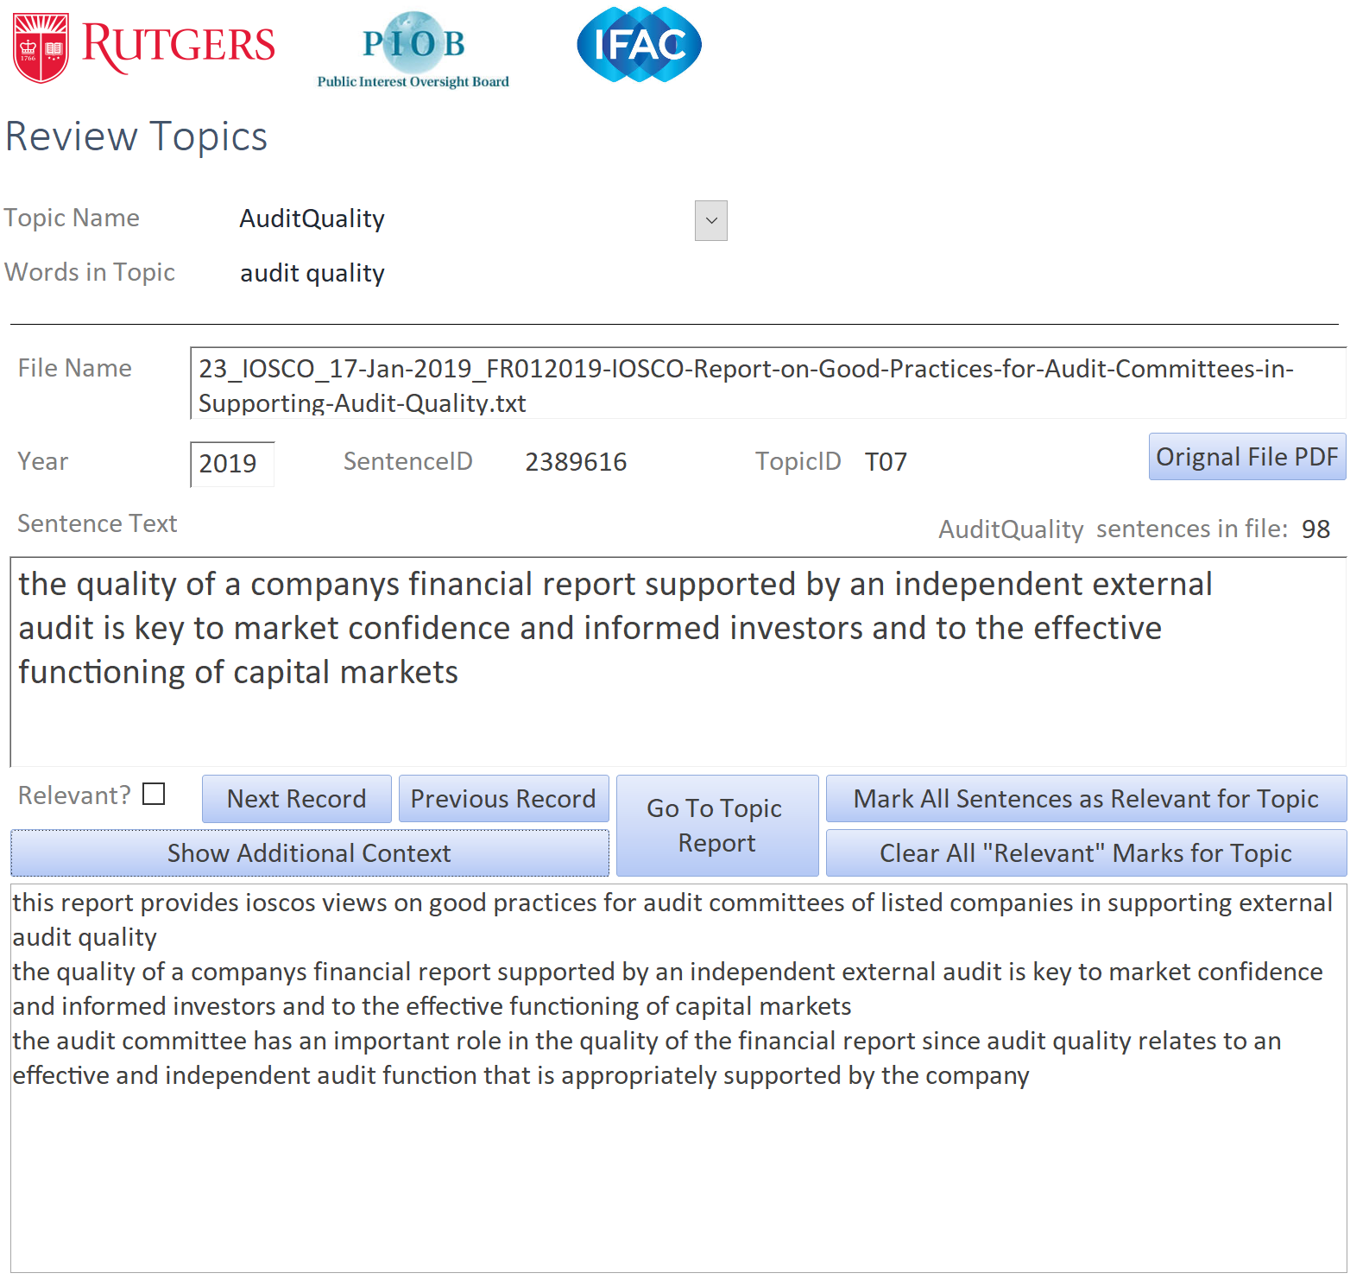

Slide 17
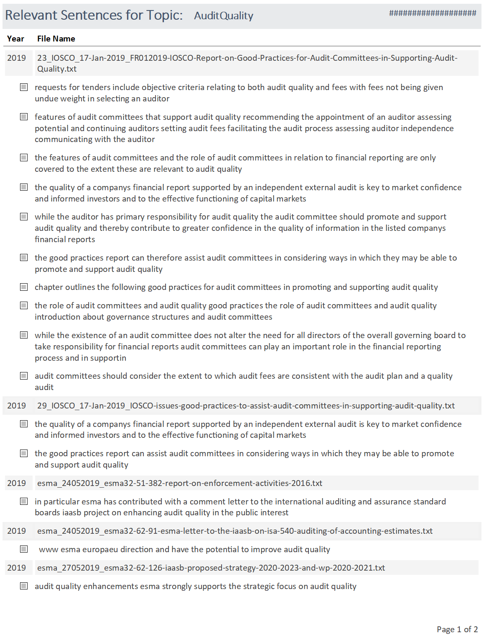

Slide 18
Conclusion and Next Steps
Useful information for PIOB’s mission can be automatically extracted from Internet resources
Next steps include:
More Websites
Dashboards
Time Series Analyses
Advanced Filters
Turn Project Code over to PIOB and IFAC

